Slide 1
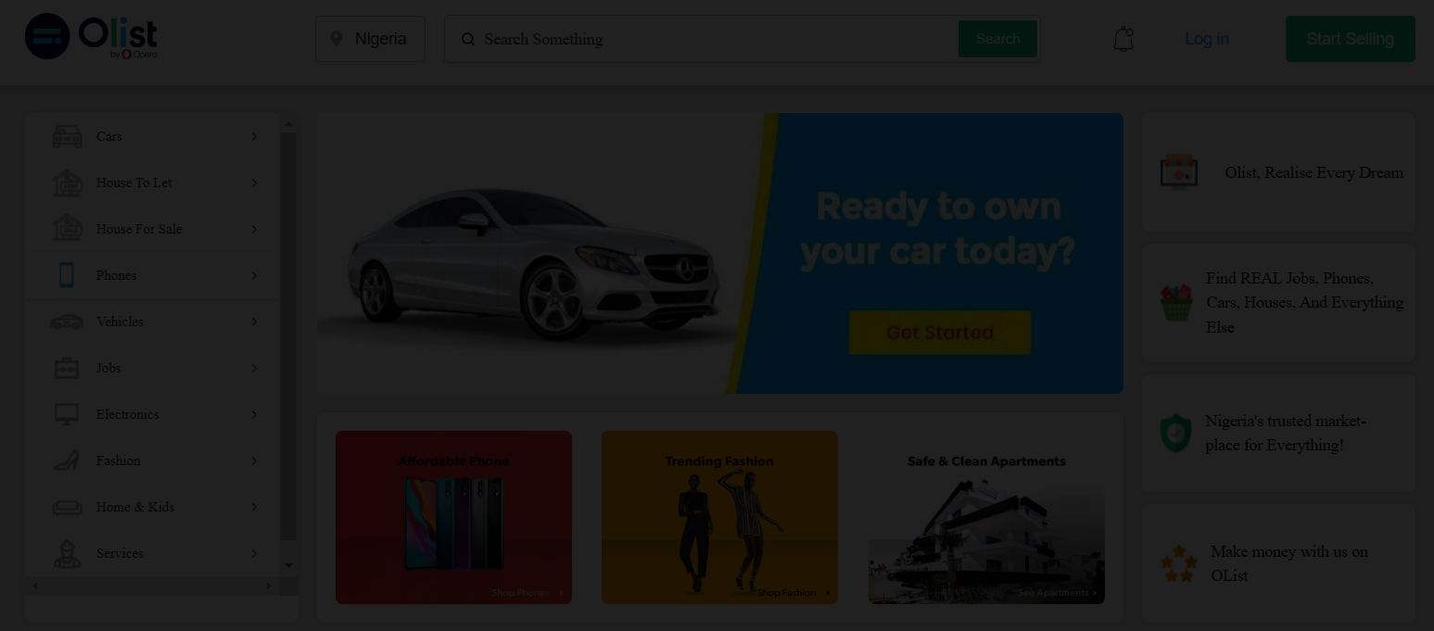
Marketing and Retail Analytics
Bharat Sharma
Haswanth Gorle
Vasundhara Kadekodi

Slide 2
About Olist
Goals and objectives
Insights and Conclusion
Agenda
Data description
RFM Modeling
Pareto analysis
Market basket analysis

Slide 3

About
Olist was founded in 2015 and has become one of the largest online marketplaces in Brazil. Their platform helps small businesses sell their products online without needing their own infrastructure or website. The platform includes a range of services and tools to help businesses sell more effectively, and they also provide data analytics to help businesses understand their customers and optimize their sales strategies.
They have also received several awards and recognitions for their innovative business model and positive impact on the e-commerce industry in Brazil.

Slide 4
Problem Statement
OList, an e-commerce company, is facing losses and wants to manage inventory effectively to reduce costs. The goal is to identify top revenue generating products and analyze customer purchase behavior using market basket analysis. This analysis will help identify products that are more likely to be purchased individually or in combination with others. The company aims to reduce the number of items in specific categories without significantly impacting business.

Slide 5


Goals and objectives
01
Identify top products that contribute to revenue.
02
Analyze customer purchase behavior through market basket analysis.
03
Determine the ideal category depth for OList's inventory.
04
Reduce the number of items in a particular category to optimize inventory cost.

Slide 6
Data description
The available dataset, called "Retail_dataset," is in the form of an xlsx file or spreadsheet and contains five worksheets.
Orders: Sheet contains information about orders, including order ID, customer ID, order status, purchase and delivery timestamps, and estimated delivery dates.
Order_Items: sheet contains details about each order item, such as the order ID, item ID, product ID, seller ID, price, and shipping charges.
Products: sheet includes information about the products available at the Olist Warehouse, such as their ID, category name, weight, length, height, and width.

Slide 7
Data description
Payments: sheet contains data on payments made for each order, including the order ID, payment sequential number, payment type, number of installments, and payment value.
Customers: sheet includes information about the customers, including their ID, zip code prefix, city, and state.
In total, there are 32,951 products available at the Olist Warehouse, 99,441 orders placed, 96,096 unique customers, and 3,345 repeat customers. The transactions in the dataset span from September 2016 to September 2018.

Slide 8
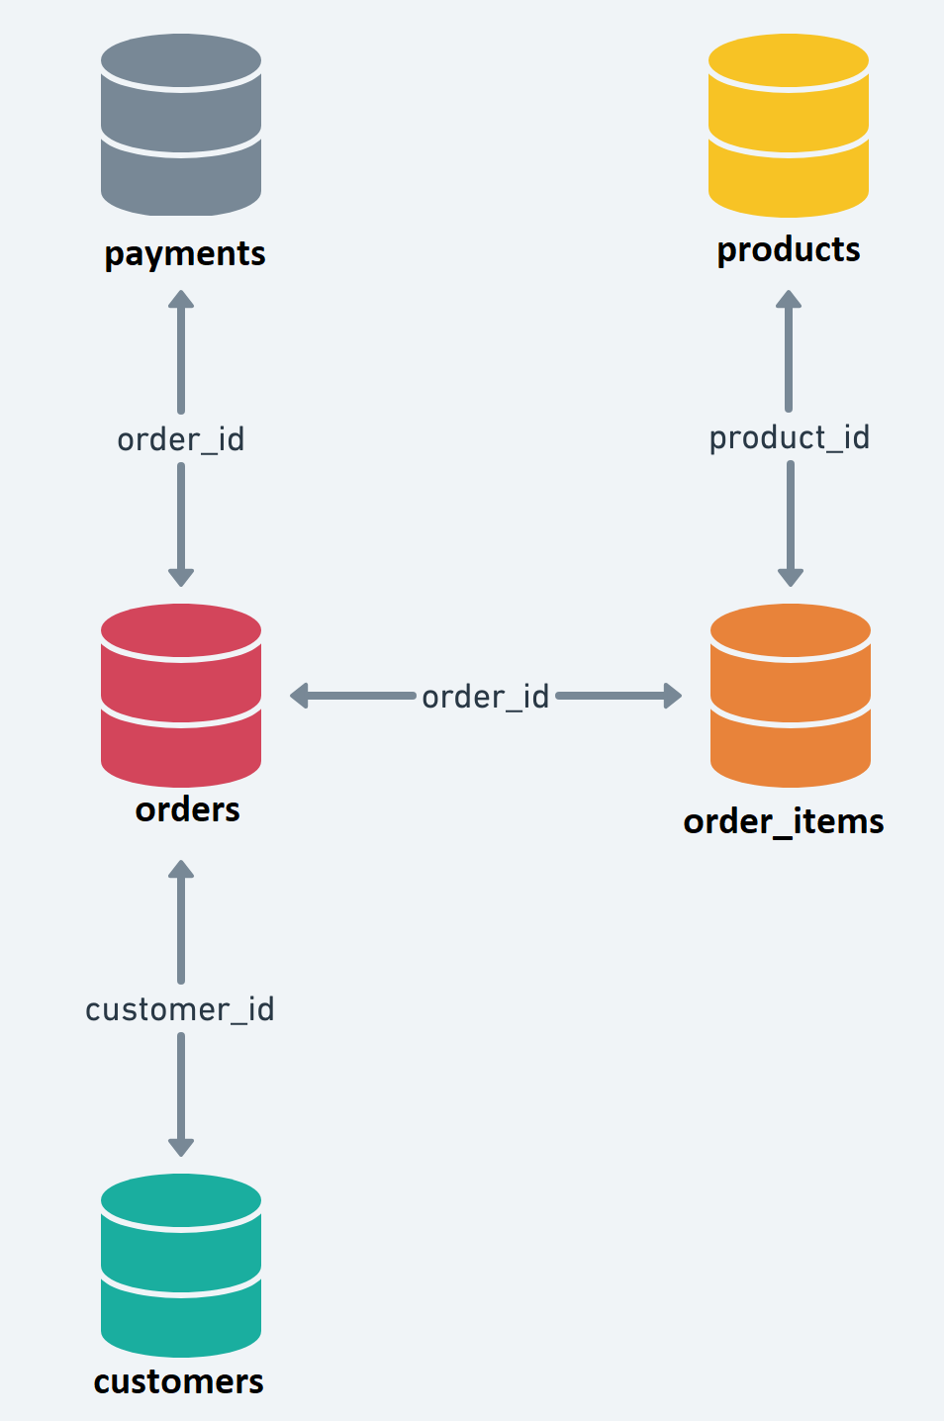
Entity Relationship Diagram (ERD)
To combine all the sheets in the "Retail_dataset" using the shared fields indicated in the Entity Relationship Diagram, you can utilize the merge function in pandas.

Slide 9
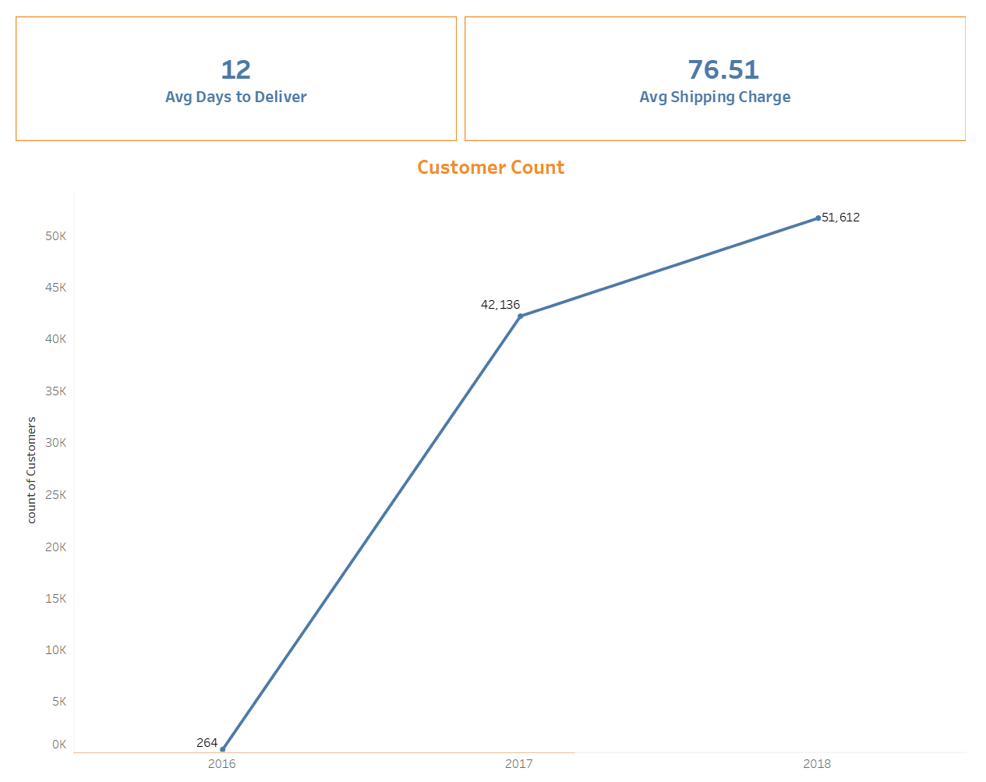

Overview of the Dataset

Slide 10
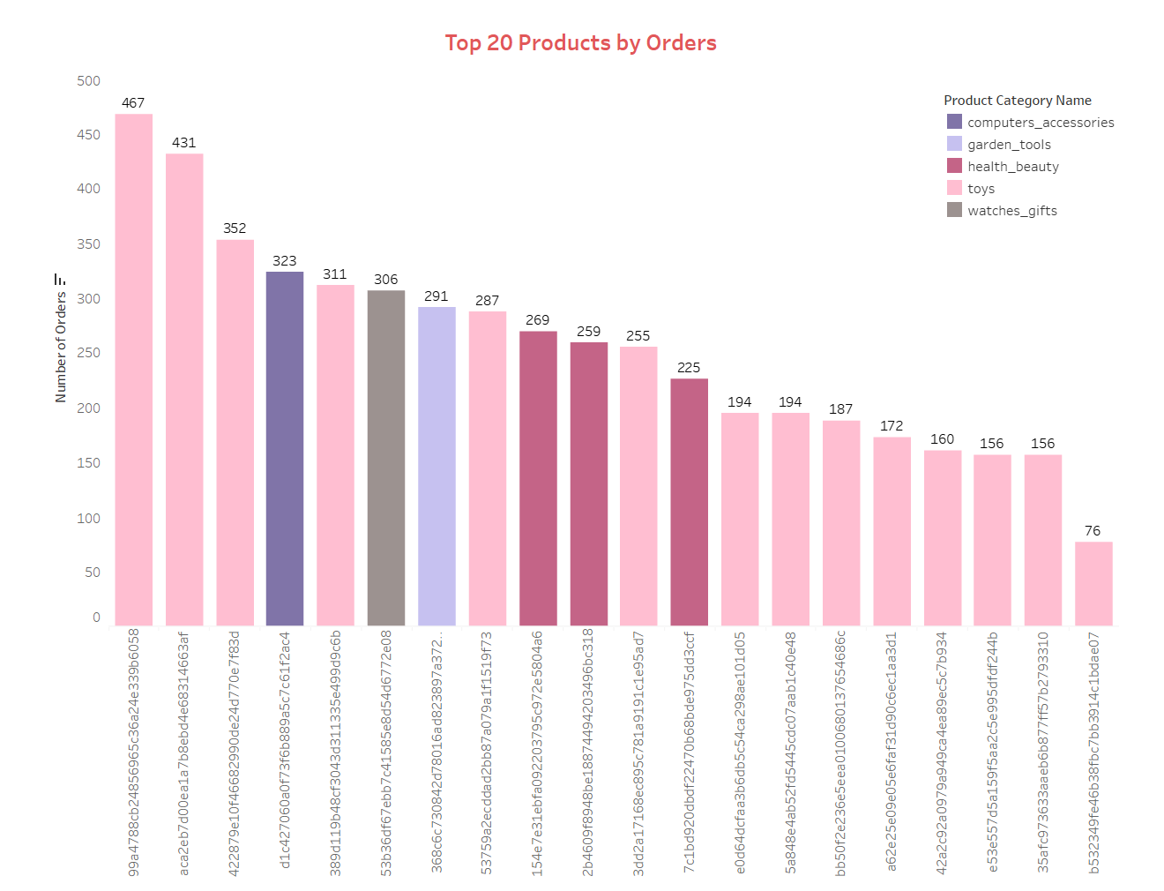
Top 20 Products by Orders
Based on the given bar chart:
Product ID "99a4788cb24856965c36a24e339b6058" has the highest number of orders with a total of 467.
Product ID "aca2eb7d00eala7b8ebd4e68314663ar" has the second-highest number of orders with a total of 431.
Product ID "b5323491e46b38fbc7bb3914c1bdae07" has the lowest number of orders with only 76.

Slide 11

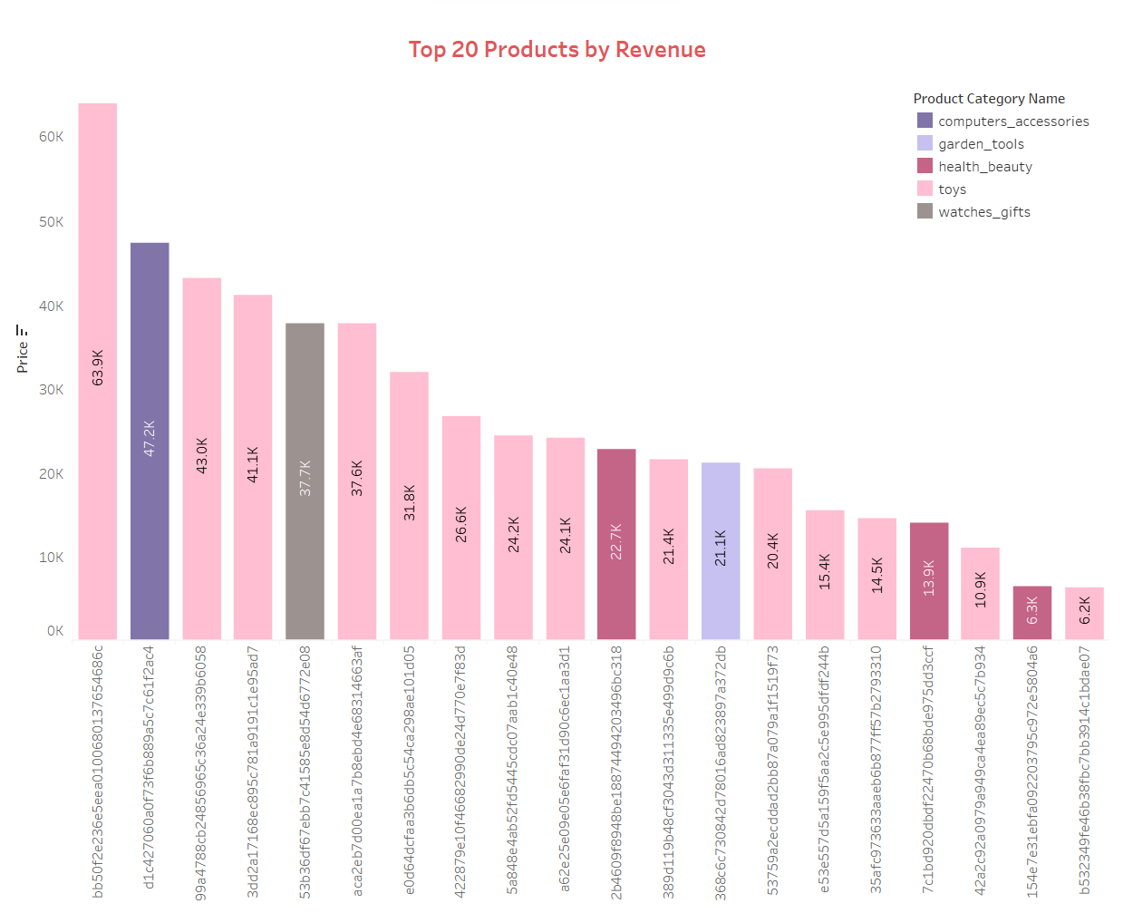
Top 20 Products by Revenue
Based on the given bar chart:
Product ID "bb50f2e236e5eea0100680137654686c" generates the highest revenue among the top 20 products with a total of 63.9K.
Product ID "d1c427060a0173165889a5c7c61f2ac4" follows with 47.2K revenue.
Product ID "99a4788cb24856965c36a24e339b6058" follows with 43.0K revenue.
Product ID "b532349fe46b38fbc7bb3914c1bdae07" has the lowest revenue of 6.2K among the top 20 products ranked by revenue.

Slide 12
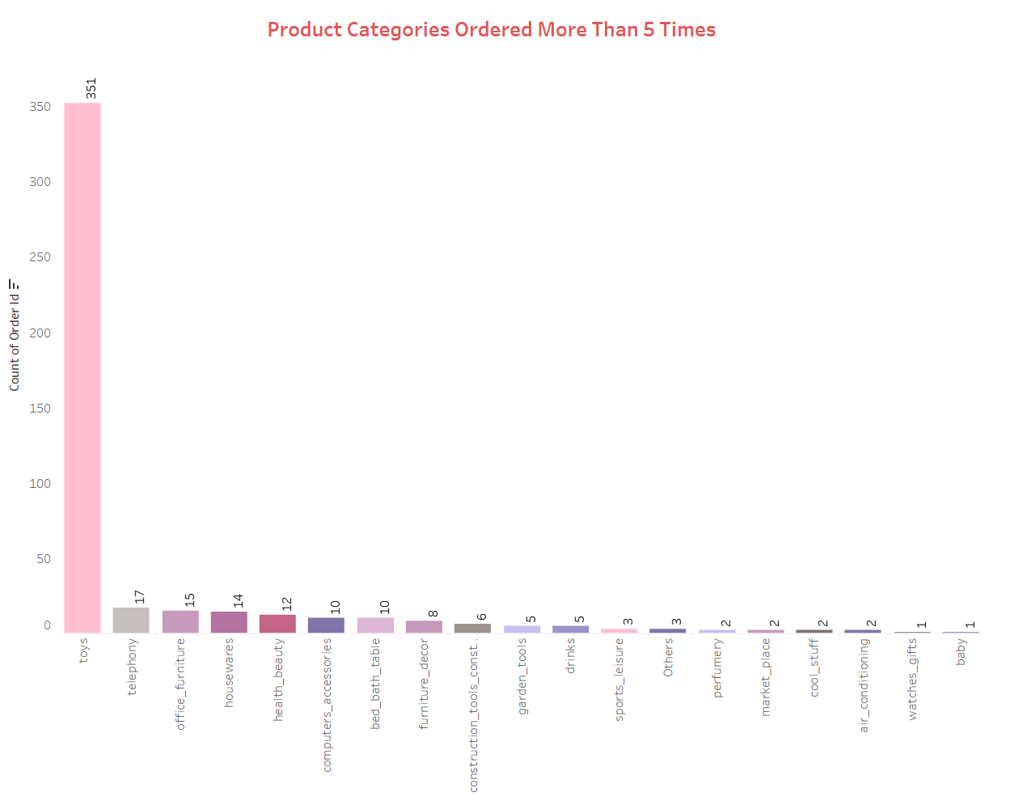
Product Categories Orderd More than 5 Times
Based on the given bar chart:
The "Toys" product category has been ordered more than 5 times with a total of 351 orders.
The "Telephony" category follows with 17 orders.
The "Office_Furniture" category is ordered 15 times.
The "Watches_Gifts" and "Baby_Products" categories have only been ordered once.

Slide 13
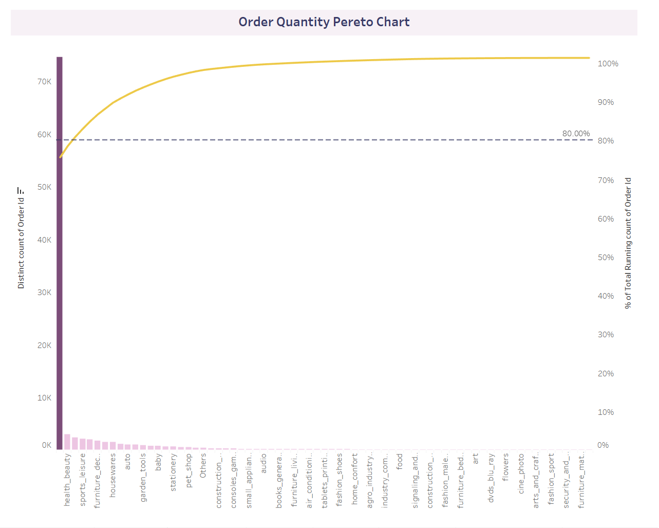
Pereto Chart by Order Quantity
Based on the Pareto Analysis, it can be concluded that the top three product categories, namely "Toys," "Health_Beauty," and "Bed_Bath_Table," account for 80.89% of total orders. Therefore, these categories can be considered high-priority inventory items and should be monitored closely.
For the remaining 19.11% of orders, the product categories can be categorized into medium and low priority groups based on their order counts.
This categorization of inventory items can help in prioritizing and monitoring the top-selling items while ensuring that the other categories are also managed effectively.

Slide 14
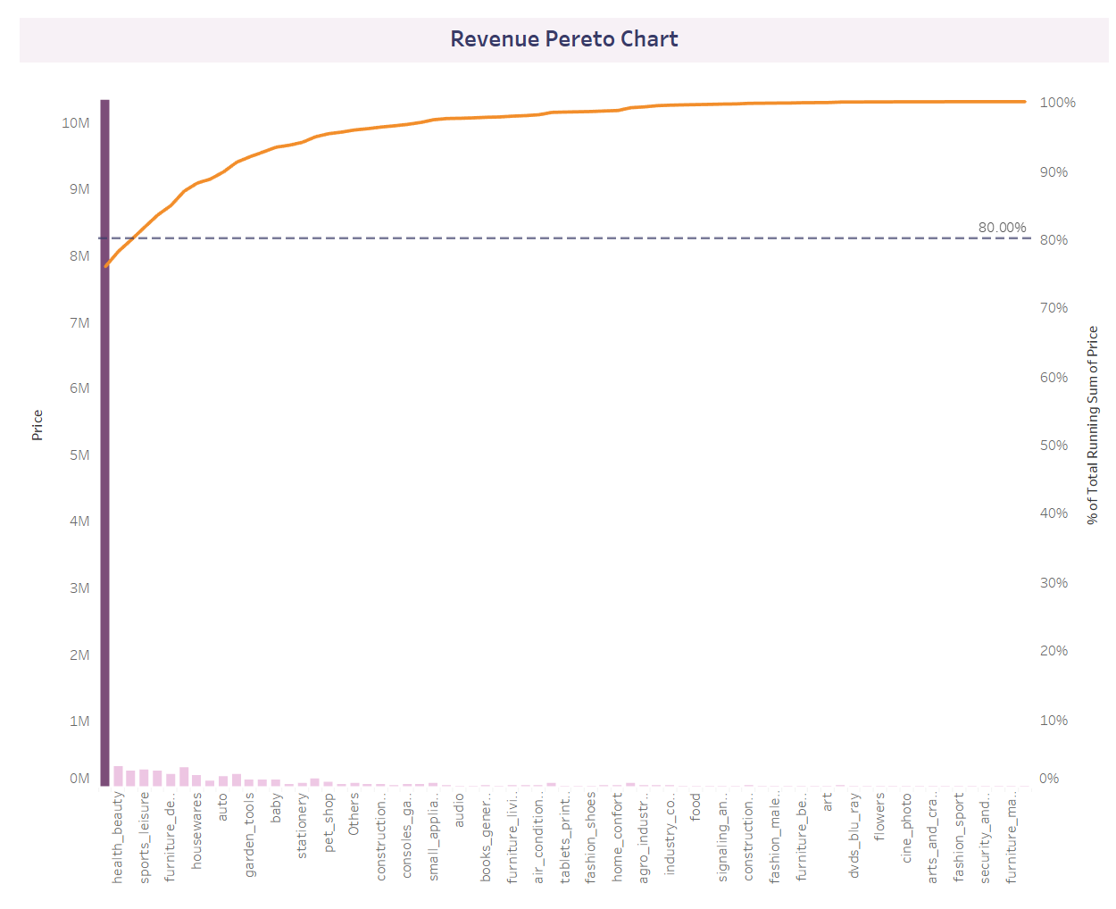
Pereto Chart by Revenue
"Toys," "Health_Beauty," and "Watches_Gifts" product categories generated 80.24% of the total revenue, making them high-priority inventory items to monitor.
The remaining 70+ product categories contributed to the remaining 19.76% of the revenue and can be divided into medium and low priority groups based on their revenue generation potential.
Categorizing inventory items can help prioritize and monitor top revenue-generating products while effectively managing other categories.

Slide 15
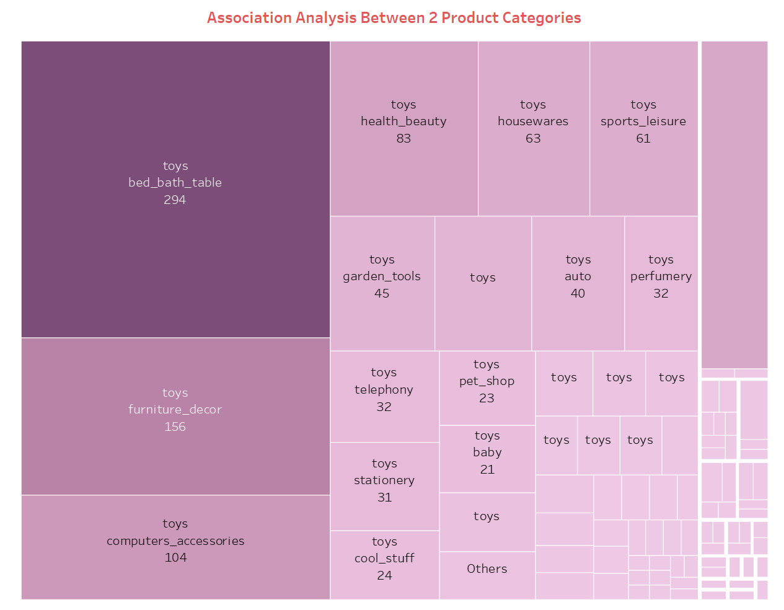
Association Analysis between product Categories
The market basket analysis indicates that "Toys" and "Bed_Bath_Table" are purchased together 294 times.
The combination of "Toys" and "Furniture_Decor" is purchased 156 times, followed by "Toys" and "Computer_Accessories" with 104 times.
This information can be useful for identifying popular product combinations, creating targeted marketing strategies, and optimizing product placement in stores.

Slide 16

RFM Modeling
The RFM score assignment method was used to categorize products in the Olist warehouse based on their recency, frequency, and monetary value.
The six resulting categories are: Superhit Products, High-Value Products, Fast Moving Products, Average Sale Products, Infrequent Products, and Costly Products.
Each category represents a different level of performance across the three metrics and can help businesses identify areas for improvement in their inventory management and marketing stratergies

Slide 17
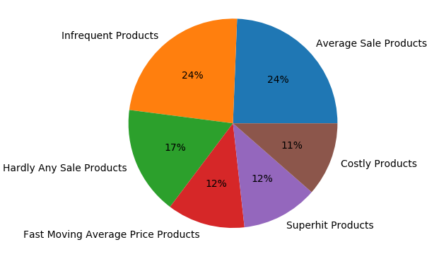
Pereto Chart by Order Quantity
"Infrequent cheap products" is the largest category at 24%, indicating customers prefer affordable prices even if products are not bought frequently.
"Average sale" category is also 24%, suggesting that customers are willing to spend money on products offering good value for money.
"Superhit Products" and "Fast moving average price products" are equally popular and have a share of 12% each.
"Hardly any sale product" has a share of 17%, indicating that some products are not selling well and may need re-evaluation of product offerings or marketing strategies.
"Costly product" has a share of 11%, indicating that fewer products are priced higher and may need to be promoted or priced lower to increase sales.

Slide 18
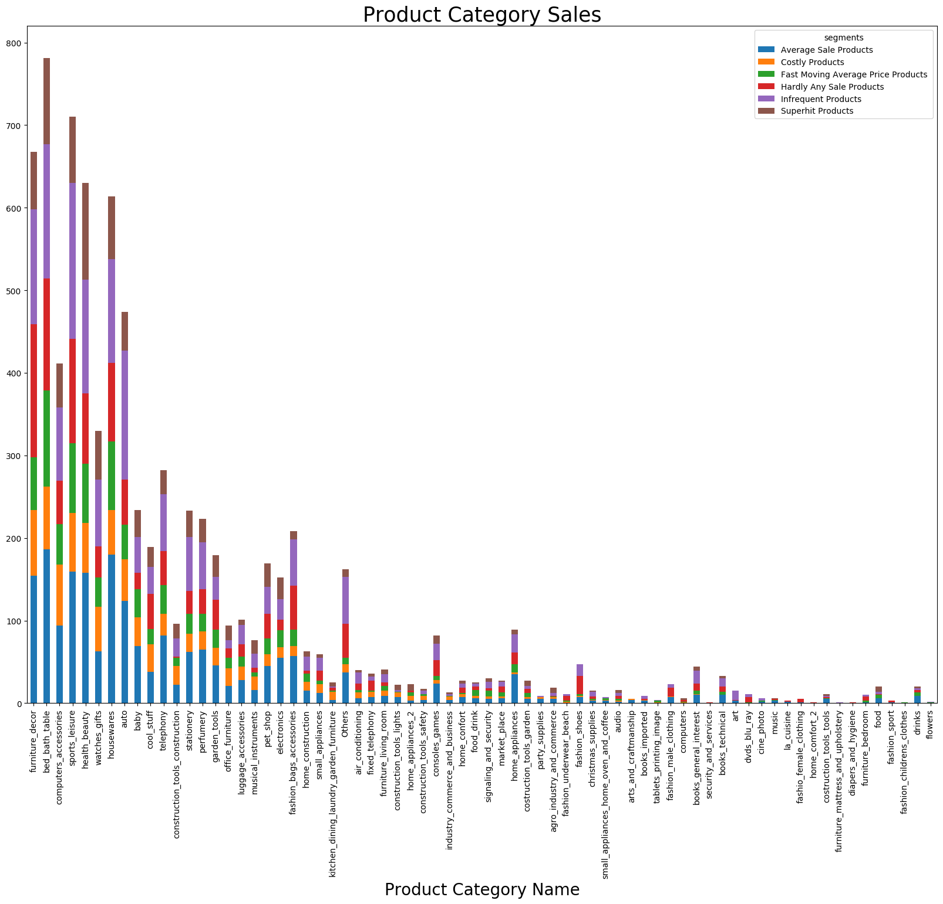
Product Segment
The "average sale product" and "infrequent product" segments have the highest number of products in each category.
The "fast-moving average price product," "costly product," and "super hit product" segments have the least number of products in each category.
There is also a high number of products in the "hardly any sale product" segment.

Slide 19
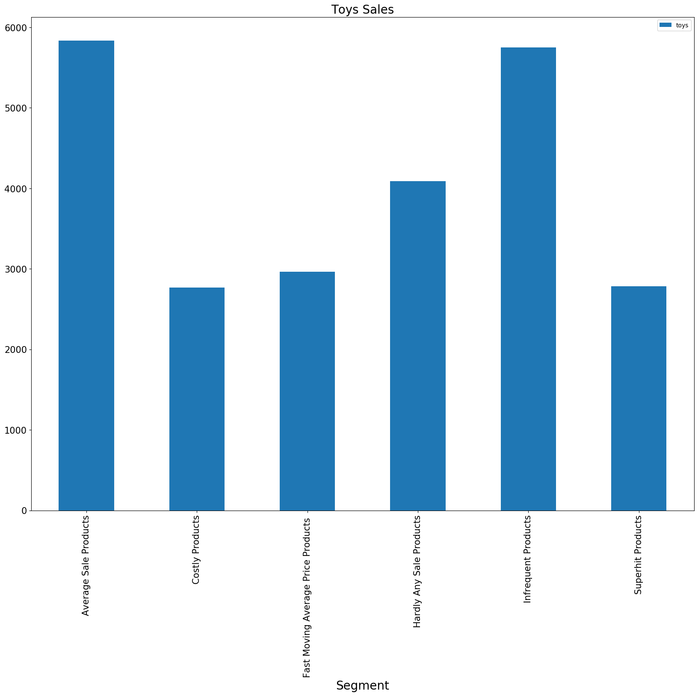
Toys Segment
The "infrequent products" segment has the highest number of products in the Toys category, indicating a larger variety of products that are sold less frequently.
The "average sale product" segment is the second-highest, suggesting a significant number of products with moderate sales.
The "superhit products" segment has the least number of products, indicating fewer products that are particularly popular. There may be opportunities to increase sales in this segment through effective promotion or pricing adjustments. Meanwhile, unprofitable products in the "infrequent products" segment should be considered for reduction.

Slide 20
Conclusion
Effective inventory management is crucial for the success and profitability of any e-commerce business, and OList's approach to analyzing sales data to prioritize and monitor top-performing products and categories is a sound strategy.
The use of Pareto analysis allows businesses to identify the 20% of products or categories that account for 80% of total orders and revenue. By focusing on these top performers, businesses can allocate resources more effectively and streamline their operations.
RFM modeling provides a more detailed view of customer behavior, allowing businesses to segment products based on recency, frequency, and monetary value. This information can be used to tailor marketing strategies and inventory management practices to specific customer groups and optimize overall performance.
By implementing data-driven inventory management strategies, businesses like OList can reduce costs, improve profitability, and enhance the overall customer experience. This is especially important in the highly competitive and rapidly evolving e-commerce landscape, where efficient operations and effective marketing are critical for success.

Slide 21
Insights
The "Toys" category is a high-priority inventory item, accounting for a significant portion of total orders and revenue. However, it also has a large number of infrequent products, which should be considered for reduction.
The market basket analysis indicated that "Toys" and "Bed_Bath_Table" are frequently purchased together, suggesting that placing these products together can lead to increased sales.
The RFM modeling revealed that a significant portion of sales come from affordable products that are sold less frequently and products that are sold at an average price point.
The "superhit products" segment has the least number of products, indicating opportunities for effective promotion or pricing adjustments to increase sales.

Slide 22
Recommendations:
Monitor the "Toys," "Health_Beauty," and "Bed_Bath_Table" categories closely as they account for a significant portion of total orders and revenue.
Consider reducing the number of infrequent products in the "Toys" category to optimize inventory management.
Place "Toys" and "Bed_Bath_Table" products together to encourage more purchases.
Develop targeted marketing strategies for products in the "superhit products" segment to increase sales.
Consider pricing adjustments or effective promotion for products in the "hardly any sale product" segment.

Slide 23
Thank You

